Slide 1
Clinical Research Support Office (CRSO)

Slide 2
CRSO Mission
To make it easier for investigators to conduct quality
clinical research

Slide 3
Clinical Research Support Office
The CRSO is a central office that can support your research:
Research Staffing Core
Clinical Trial Support
OnCore Support
REDCap Support
Recruitment Enhancement Core
IND/IDE Support Program (FDA Investigational New Drug/Investigational Device Exemption)
Clinical Trials Financial Management

Slide 4
Research staffing core
Diverse staff for all kinds of clinical research
Full and part-time
All lengths of assignments
Flexibility to meet your staffing needs

Slide 5
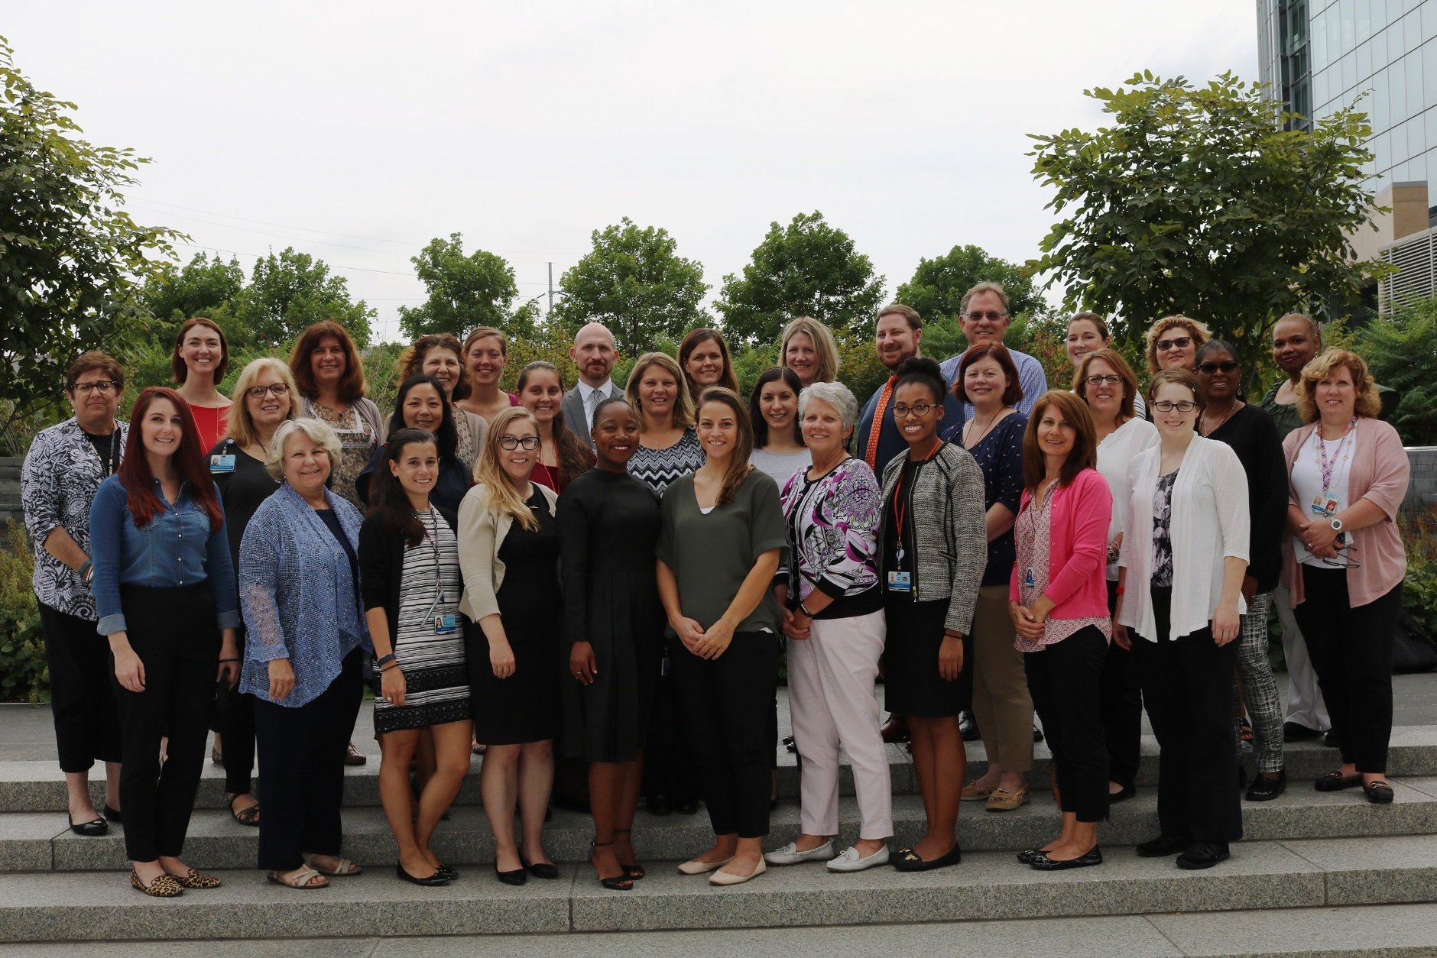
Research Staffing Core
Michele Toms, BSN, RN, CCRP
Administrative Director

Slide 6
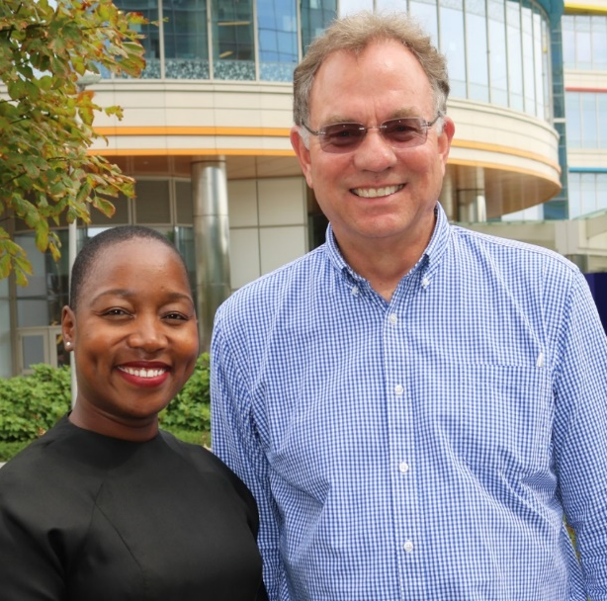
Clinical Trial Support
OnCore Support
REDCap Support
Recruitment Enhancement Core
IND/IDE Support Program
August Gwafila, RN
IND/IDE Program Manager
Greg Podsakoff, MD
Director Clinical Trials
Kristina Harr, JD
Administrative Director

Slide 7
Clinical trials financial management (CTFM)
CTFM provides a range of financial management services:
Prepare, negotiate and review study budgets
Create billing plans that list billable procedures per study protocol
Register & schedule research patients in EPIC
Invoice sponsors, manage receivables & recover salaries
Financial Reports and grant closeouts

Slide 8
Contact CRSO
Research Staffing Core Administrative director | Michele Toms, BSN, RN, CCRP TOMS@email.chop.edu
Clinical Trial Support, Administrative director | Kristina Harr, JD HarrK@email.chop.edu
Oncore support | oncore@email.chop.edu
Redcap support | REDCAp@email.chop.edu
Recruitment enhancement core | Lindsey Demarco: DEMARCOLM@EMAIL.CHOP.EDU Valerie laranako: LARANKOV@EMAIL.CHOP.EDU
IND/IDE Support Program | Greg Podsakoff, MD: Podsakoff@email.chop.edu August Gwafila, RN: GwafilaB@email.chop.edu

Slide 9
Contact CRSO - CTFM
Director | Ronnie Kain, MBA kainv@email.chop.edu 267-426-0129
Research Registration, Charge Review manager | Hien Oehler OehlerH@email.chop.edu 267-425-1382
Clinical research financial manager | Brittany schliep GirardB@email.chop.edu 267-425-2106
Clinical research accountant manager | Nathalie daniel danieln@email.chop.edu 267-426-9194

